Slide 1

Trinkt!
App Prototype
A presentation by:
Valerie, Jimmy, Brayden

Slide 2

Trinkt! and the issue of collectible sharing online
Trinkt! is an app aimed at building a dedicated space for collectors of any kind across the world to share their collectibles and trade them with others.
Right now, there are only a few apps that address this need, and they aren’t accessible to all users.
Most collectors share their collections in community spaces on apps like Reddit and Discord because they have nowhere else to go.

Slide 3

The solution
Trinkt! solves this issue by creating a central hub that anyone can join and contribute to with their own personalized user.
With a focus on intuitive UI and user posts, our app lets collectors share and see any type of collection they want.
Users can interact with any other collectors through chats and and their collectible posts .

Slide 4


Target audience:
Users
Our Goal
We’re focused on collectors of any skill or interest level who want to share their collectibles for others to see.
We want to appeal to users who need an easy way to put together a collection in any category and have the tools to manage it.
‹#›

Slide 5

Trinkt!’s Main Features:
Single posts
Collection posts
Trading
Messaging other users
User Profile
The depth these of these features meant that we needed to ensure we didn’t overwhelm casual users. This is where our personas came in.
‹#›

Slide 6

How we planned our personas:
Because our app is targeted at such a broad category of collectors, we needed to make sure our app design would account for different skill levels and use cases.
Trinkt! is accessible for a casual user experience because of its straightforward flow design, but has a lot of deeper features that appeal to our primary and casual users.
‹#›

Slide 7

Our Personas:
In order of Primary, Power, and Casual
‹#›

Slide 8
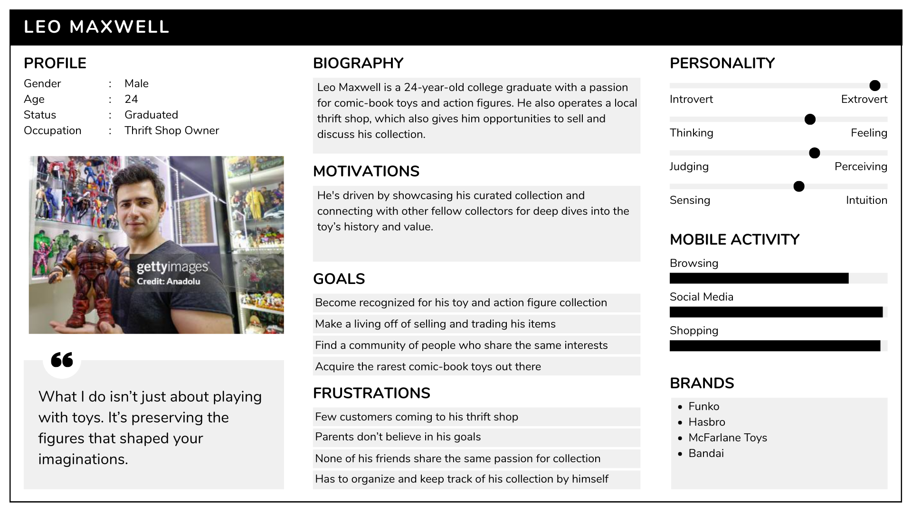

Slide 9
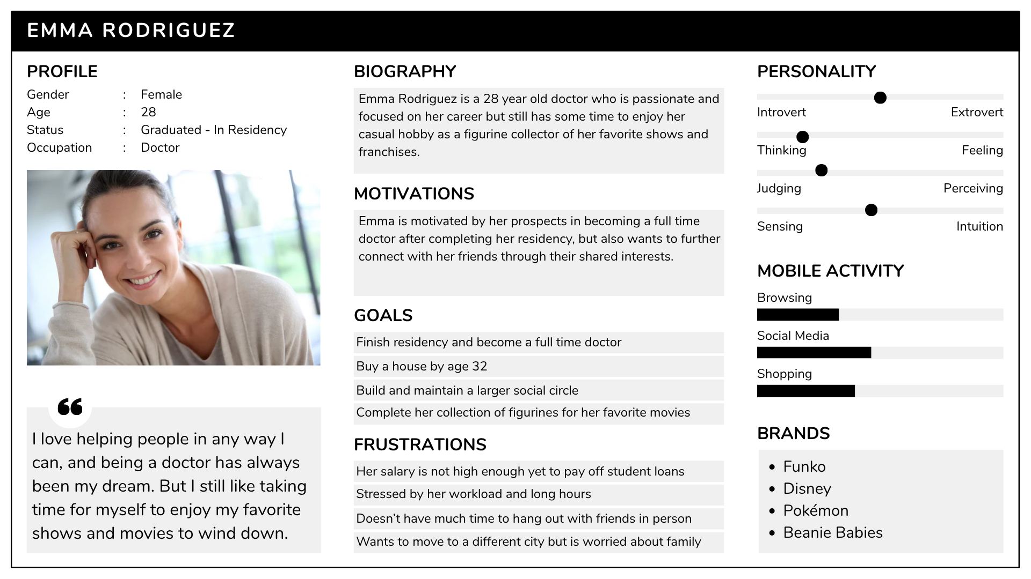

Slide 10
The Original Trinkt! App Proposal and our Iterations:
The original app proposal outlined a similar product to ours, but wasn’t as fleshed out
The designers explained that Trinkt! was an app for sharing collectibles, and the main hook was that it would provide a simple UI for creating collections of thousands of items.
We took this idea and tried to adapt it into a functional prototype by focusing on how users would be able to interact with the Trinkt! UI and making the collectible posts easy to access and simple.
‹#›

Slide 11
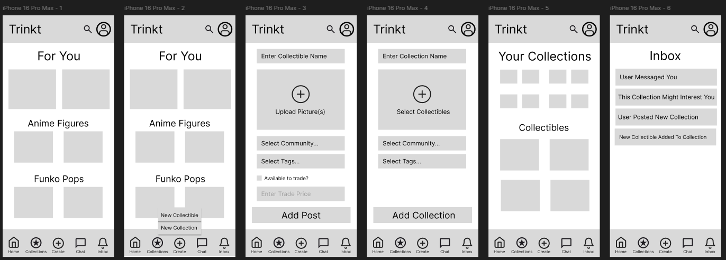
Wireframes:
User home page
All app icons and user flow demonstration of create button
Collectible post creation page and its flow
‹#›

Slide 12
Wireframes:
Collection creation page and flow
User profile page and its format for posts and collections
Inbox where updates and message notifications are displayed
‹#›

Slide 13
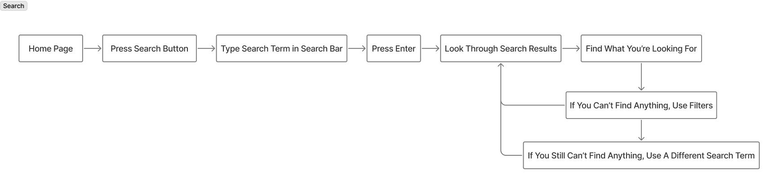
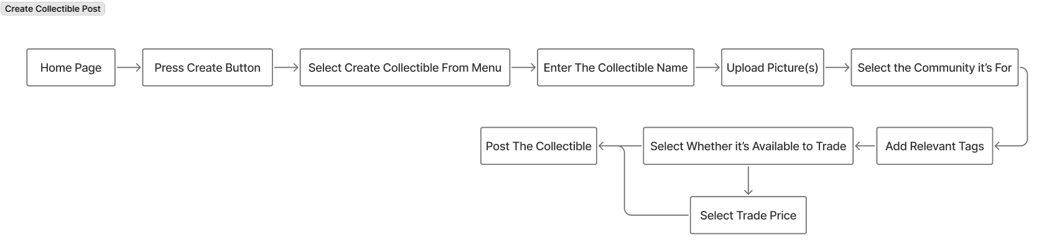
Primary User Example Flows:
‹#›

Slide 14
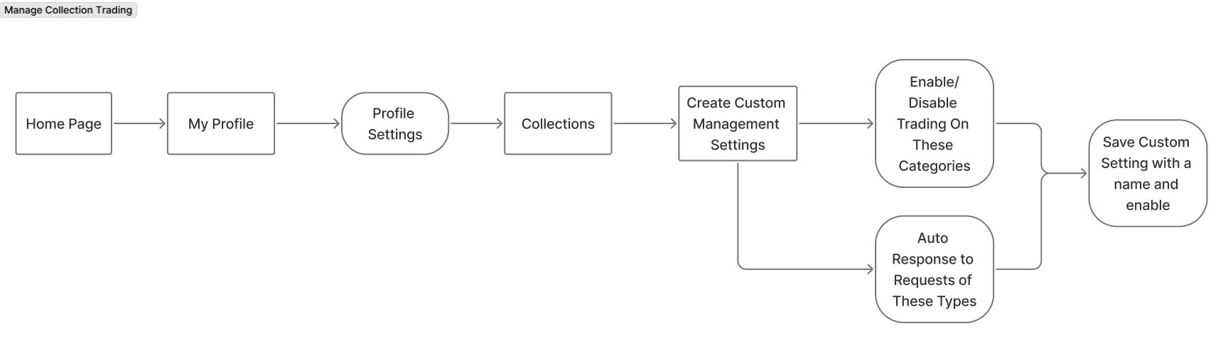
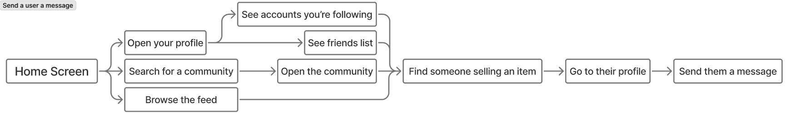
Power User Example Flow:
Casual User Example Flow:
‹#›

Slide 15
High-Fidelity Prototype

Slide 16

How we tested the app:
We had users work through a few user flow tasks on our wireframes and asked them questions about how intuitive they thought the process was for completing each one.
The testing showed that our app was overall effective and intuitive for most users and that the design plan was a success.
Overall the results indicated that the wireframe design was easy to navigate, but we found a few things to improve such as making names clearer and changing some icons to be more intuitive.
‹#›

Slide 17

How our app turned out and what
it accomplishes:
Our prototype demonstrates a simple and effective solution for collectors who want to share their vast collections with the rest of the world all in one app.
Trinkt!’s task flow has been streamlined for the primary user so that any feature of the app is easily accessed from any page, and the design has been tested to be intuitive so that even casual users can figure out how to post their own collections.
We are confident that our product will be a successful.
‹#›

Slide 18

Thank You.
Any questions?
Trinkt!

